Slide 1
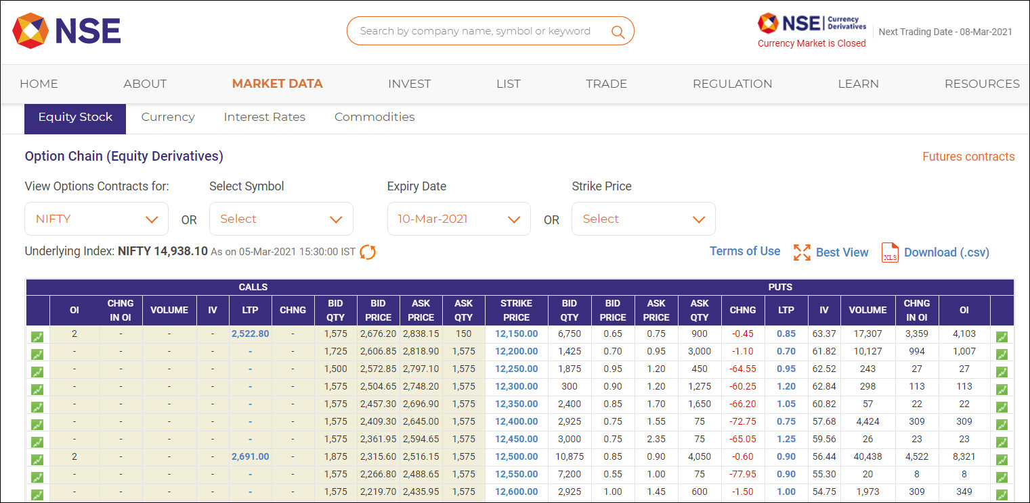
Options Chain Tool
Edelweiss Global Markets Hackathon
Team name: Star Techies

Slide 2
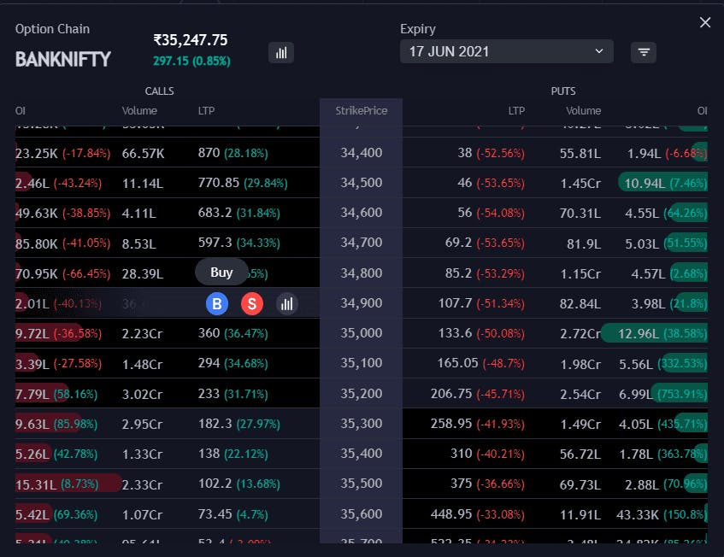
What is Option Chain
It can be described as the listing of all option contracts. It includes both puts and calls for a specific security. It is also known as an Option Matrix and is considered useful for trading on the following day.
With the help of Option Matrix, skilled users can decipher the direction of price movements. It also helps to identify the points at which a high or low level of liquidity appears. Typically, it permits traders to evaluate the depth and liquidity of specific strikes. It captures these following metrics successfully –
Executed price
Real-time bid price
Ask price
Ask quantity
Bid quantity

Slide 3
What we have tried to build
The goal is to build a real-time options chain screen similar to the one found on the NSE India website (https://www.nseindia.com/option-chain). The options chain screen will display market data and calculate various metrics, including implied volatility (IV), based on the Black Scholes Formula. The following points should be considered:
Display: The options chain screen should display the options data in a tabular format, similar to the NSE India website. It should differentiate "in the money" and "out of the money" options using different highlighting or styling.
Selection: The screen should provide options to select the underlying asset and different expiration dates. This allows users to view options for different assets and expiries.
Real-time Updates: The options chain should update in real-time as the market data changes. This means the displayed fields, including metrics like IV, should be recalculated and refreshed without requiring a page reload in the browser.

Slide 4
What we have tried to build
Implied Volatility (IV) Calculation: The IV calculation should be based on the Black Scholes Formula, which is a widely used options pricing model. The formula requires the options price, risk-free interest rate, time to maturity (TTM), and underlying asset price.
By building this options chain screen, you can process the market data, calculate various metrics such as IV, and display the options data in a user-friendly format. The screen should update in real-time, providing traders and investors with up-to-date information on options prices and other important metrics.

Slide 5
What problem you we solving
The problem being solved is to develop a real-time options chain screen. The options chain screen aims to provide traders and investors with a user-friendly interface to view and analyze options data. The screen will process market data received over TCP/IP and calculate metrics such as implied volatility (IV) using the Black Scholes Formula. The goal is to create a webpage similar to the NSE India option chain, offering the following features:
Options Chain Display: Presenting options data in a tabular format, allowing users to view options for different underlying assets and expiries.
In-the-Money and Out-of-the-Money Differentiation: Highlighting in-the-money and out-of-the-money options differently to easily identify their status.
Real-time Updates: Providing real-time updates of options data without the need for page reloads, ensuring that fields and metrics, such as IV, are recalculated and refreshed as the market data changes.
By solving this problem, the options chain screen addresses the need for traders and investors to access and analyze options data in a convenient and efficient manner. It simplifies the process of tracking options prices, identifying in-the-money and out-of-the-money options, and calculating metrics like IV, aiding decision-making in options trading and investment strategies.

Slide 6
Why our application/solution should be considered for the final round.
Our application/solution should be considered for the final round because we have developed a cutting-edge real-time options chain screen that offers a range of advanced features and benefits. Here's why our solution stands out from the rest:
Robust and User-Friendly Interface: Our options chain screen provides a sleek and intuitive interface, ensuring a seamless user experience. The tabular format allows traders and investors to easily navigate and analyze options data, making informed decisions.
Real-Time Updates and Refresh: Unlike static options chain screens, our solution offers real-time updates without the need for page reloads. As market data changes, fields and metrics are dynamically recalculated and refreshed, ensuring users have access to the most up-to-date information at all times.
Accurate Implied Volatility Calculation: Our solution incorporates the Black Scholes Formula to calculate implied volatility (IV) accurately. By considering options prices, risk-free interest rate, time to maturity, and underlying asset price, we provide reliable and precise IV values, empowering users with essential insights for options trading strategies.

Slide 7
Customization Options: We understand that traders have unique preferences and requirements. Hence, our solution offers customization options, allowing users to select different underlying assets, expiration dates, and view personalized options chains. This flexibility ensures our application caters to diverse trading needs.
Visual Differentiation of In-the-Money and Out-of-the-Money Options: Our options chain screen employs visually distinct highlighting or styling to differentiate in-the-money and out-of-the-money options. This feature makes it effortless for users to identify the status of each option and make strategic decisions accordingly.
Reliability and Scalability: Our solution is built on a robust and scalable architecture, capable of handling large volumes of market data and delivering real-time updates without compromising performance. It is designed to meet the demands of high-frequency trading environments, ensuring reliability and accuracy in all market conditions.
Demonstrated Expertise and Track Record: Our team comprises experienced professionals with extensive knowledge in options trading, financial markets, and web development. We have a proven track record of delivering successful solutions, and our application has undergone rigorous testing and refinement to ensure its effectiveness and reliability.

Slide 8
Conclusion
Our application offers a feature-rich, user-friendly, and real-time options chain screen that empowers traders and investors with accurate data, advanced metrics, and customizable options. With its cutting-edge capabilities, intuitive interface, and emphasis on real-time updates, our solution is poised to revolutionize how options data is accessed and analyzed. By selecting our solution for the final round, you are choosing innovation, reliability, and a superior user experience in the world of options trading.

